Slide 1
Pain education: 2 sides of the same coin? Ways in which professional and public/consumer education can work together
Heather Wallace
Paul Harvard Evans

Slide 3
Learning objectives
To define ways that health professionals can explain pain properly and identify appropriate resources.
To open communication channels for experience and knowledge sharing within the pain community.

Slide 4
The best educators inspire
Can change the course of our life and who we are
Inspire us with love of their subject
Make us curious
We soak up information and retain it
We return to the subject
We keep learning
Notes:
Most of us here will have a memory of a lecturer or teacher who went beyond covering the curriculum, aroused in us curiosity about their subject and inspired us to soak up information to such an extent it is with us today.
They may even have changed the course of life and who we are. This is knowledge that we value and continually renew as new research and information ads to the subject matter.
A source of inspiration is not necessarily a teacher, sometimes it is a parent or a documentary programme – television presenters like David Attenborough who has inspired a generation of natural historians.
Inspirational educators usually talk fondly about the people who originally inspired them with a love of their subject.

Slide 5
PAIN EDUCATION Two currencies, two coins?
Healthcare professional
Research
Teaching/mentoring students
Clinical work
Public education
Support groups run by patients
Self management programmes
Helplines run by charities
Notes:
As healthcare professionals you are in the job of education, reading up on new research and adding to it. You are experts in evidence-based care, multi-disciplinary management, bio-psycho-social assessment.
You teach and/or mentor junior colleagues. You use your training in your clinics, where you also apply empathy and communication skills.
Parallel to your services, some of your patients may run a support group. There may even be a self management programme where trained ‘expert patients’ teach others basic pain management skills. Helplines are another common resource.

Slide 6
Ingrained beliefs and prejudices
pain must mean damage
there must be a cause
pull yourself together
you look fine
pain killers
are addictive,
have toxic side-effects
will make you fat
will stop working
Notes:
Living with chronic pain is difficult. You face ingrained beliefs and prejudices.

Slide 7
Ingrained beliefs and prejudices
Physiotherapy makes your pain worse; what’s the point of trying it again.
Mindfulness smacks of Buddhism; it clashes with your beliefs.
Super human efforts are needed every day to remain positive – and you are utterly exhausted.
You are gloomy about ever getting back to work – who would want you?

Slide 8
Patrick Wall’s “Therapeutic community”
The problem:
the experiences of a person in pain depend significantly on their beliefs about it.
His solution is to create a “therapeutic community” that will:
attack prejudice
sweep away hampering beliefs about pain.
Notes:
Patrick Wall was Life President of Pain Concern. He understood that the experiences of a person in pain depend significantly on their beliefs about it.
He had a vision of a new “therapeutic community” that could attack prejudice and sweep away hampering beliefs about pain.

Slide 9
Therapeutic community
Healthcare professionals, patients, society
Recruit the patient as a member of his own treatment team
Patients and therapists become comrades
We must take on do-it-yourself responsibilities which require:
Education
Acceptance
Encouragement
Notes:
His vision was radical and far-reaching. His therapeutic community was inclusive. Here are some of his ideas

Slide 10
Therapeutic community
“We cannot leave it to the specialist to do all that is needful”
Defeating Pain: the war against a silent epidemic
Notes:
He didn’t want two coins; he didn’t even want two sides of one coin. He wanted to melt the silver to one liquid pool, breaking down every differentiation.

Slide 11
Three Steps of Liberation
1. Regaining the possibility of physical activity
2. Reawakening a sense of expectation
– responding with hope and confidence to every kind of assistance.
3. A positive attitude to exploration
– you are actively exploring the possibilities of a prescribed medicine, diet, exercise
Notes:
Once we are rid of prejudices, we can liberate ourselves from pain. Liberation involved three necessary steps.
He has taken us back to childhood – to a time when we were naturally curious and hopeful, and eager to learn and experiment.

Slide 12
Education
Healthcare professionals must use
knowledge and skills
“great imaginative effort”
Dry text-book education is not enough to rescue a depressed, inactive patient
Notes:
It’s best if unhelpful beliefs can be avoided in the first place. Healthcare professionals must combine their knowledge and skills with “great imaginative effort” to rescue a depressed, inactive patient. Dry text-book education is not enough.
Education must be life-changing and people must be able to sustain these changes.
Education must inspire lifelong enthusiasm for learning about pain.

Slide 13
Education
Everyone’s responsibility
Can’t be delegated to other members of the pain team
Or to consumer education groups/lay-led support services
Notes:
Education is everyone’s responsibility. You can’t delegate your responsibility to other members of the pain team or consumer education groups or lay-led support services.
If you – the expert - don’t educate about treatment, address fears and explain risk, the patient will focus on the warnings on the web or in scary leaflet that accompanies their prescription.
If you don’t explain chronic pain, then the patient will search for a “proper diagnosis”.

Slide 14
Education in a therapeutic community
Must reach beyond the clinic
Inform and support everyone affected by pain
Family
Carers
Employers
Notes:
And within a therapeutic community, it is important to inform and support everyone who is affected by pain - family members, carers, friends, employers; so there are many people to educate out with the pain clinic.

Slide 15
Mass education
Attenborough’s inspirational programmes
Authoritative content is the experts’ responsibility
Involves teamwork of dedicated, skilled professionals
Accessible but not ‘dumbed down’
Backed by marketing and publicity
Notes:
That brings me back to Attenborough, whose programmes on natural history are broadcast across the world.
Behind the inspirational programmes and attractive coffee table books are top experts ensuring the authority of the content
Teams of dedicated, skilled professionals – researchers, camera team, producers, editors use their skills to make the material accessible
They bring the subject to life and so inspire enthusiasm in listeners and readers.
There are publicity and marketing teams.
Can the pain world learn from this?

Slide 16
Pain Concern Our vision
To bring together healthcare professionals and people living with pain
People wanted:
access to support
to be kept up to date
to hear from experts
So we started publishing Pain Matters magazine
Notes:
Pain Concern started as a support group, with close links to our local pain service. People wanted on-going support but they couldn’t make the support group meetings; also they wanted to be kept abreast scientific and other developments.
So we started publishing our magazine Pain Matters.
Local experts gave talks and people who couldn’t come to these meetings asked for recordings of the talks.
.

Slide 17
Pain Concern Our vision
A channel of communication bringing together the pain community to talk about the issues
Patients of general practitioners could learn from top specialists
Benefit of peer support
A ready support system
Educate the healthcare community
We wanted to give pain a voice
Notes:
Our vision was:
A channel of communication bringing together the pain community to talk about the issues
People under the care of their GP could learn from top pain specialists and benefit from peer support;
There would be a ready support system that people could access whenever they needed it and wherever they were.
We wanted to educate healthcare professionals and inspire them to develop an interest in pain management for the benefit of their patients.
We wanted to give pain a voice.
What about a radio programme, we wondered …..

Slide 18
Airing Pain
42 podcasts also available as CDs
Evaluation completed
Reply on support of healthcare professionals
Advisory Board
Let us into your clinics so we can make interesting programmes
Help us with marketing
Help us fundraise
Notes:
At the moment there are 42 podcasts on pain. They are available as CDs – we know that not everyone can access the internet. They are a unique resource. We evaluated them in 2012 and I’ve brought copies of the executive summary with me tonight.
We are a small charity and we do need help. We have had fantastic support from our advisory board of experts. We need healthcare profession to help us by letting us interview you at work; we need your help with marketing Airing Pain, telling your patients to listen. We also need help raising money.

Slide 19
EVALUATION OF “AIRING PAIN”
DR LINDA POLLOCK
Linda.pollock5@btinternet.com

Slide 21
“AIRING PAIN”
Funded by a NAPP Chronic Pain Award
Created 2-weekly radio programmes with
Able Radio, UK’s 1st disability radio station
Targeted people in pain
Aimed to take support to sufferers in their own home
Developed 36 programmes (Sept 2010-2012)

Slide 22
METHODOLOGY
Evaluation of the listener figures
Quantitative data on number of downloads of podcasts and CDs.
David Deacon
Feedback about the most popular and least popular shows
Questionnaire
Using Survey Monkey (Simon Packer)
Descriptive info about the demography, the experience and views of listeners / professionals
Qualitative feedback about the detailed content of programmes

Slide 23
Challenge to get survey responses!
Encouragement given by Able Radio
Publicised by producer in programme
By Pain Concern in newsletters and website
via our social networks, twitter and facebook
Pain Clinics and sister charities informed
HQ made it easy to complete by telephone
120 returned: average download approx 340 (therefore roughly 30% response rate)

Slide 24
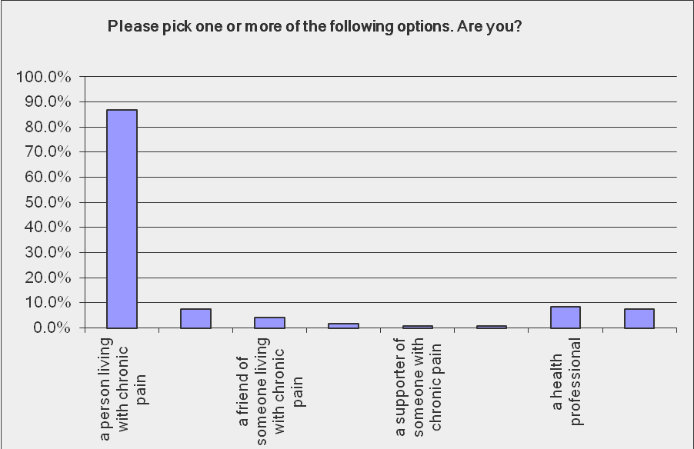

Slide 25
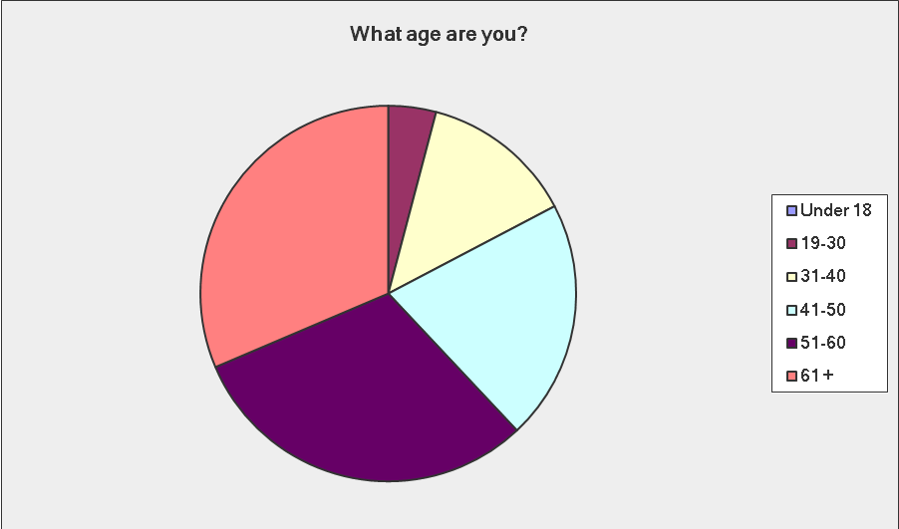
Majority of respondents older

Slide 26
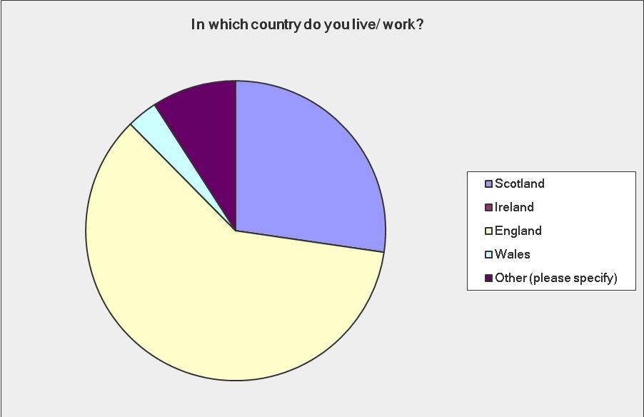
AIRING PAIN UK COVERAGE
Notes:
60% in England, 27% in Scotland. Few in Northern Ireland.
Almost 70% female, 30% male.
Some international: almost 10 % abroad.

Slide 27
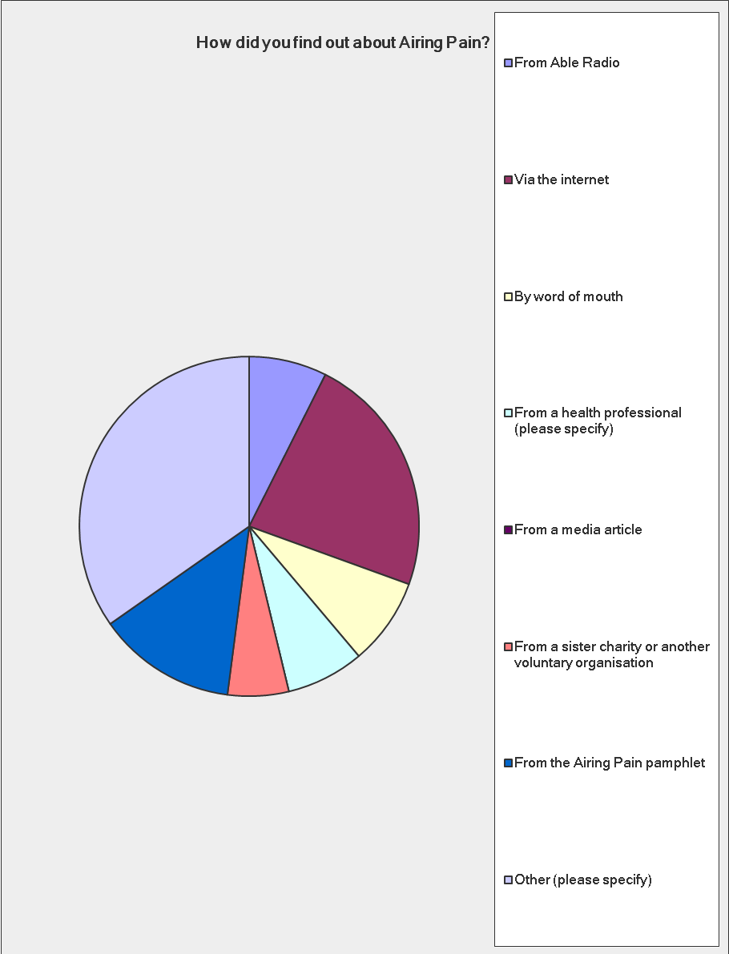

Slide 28
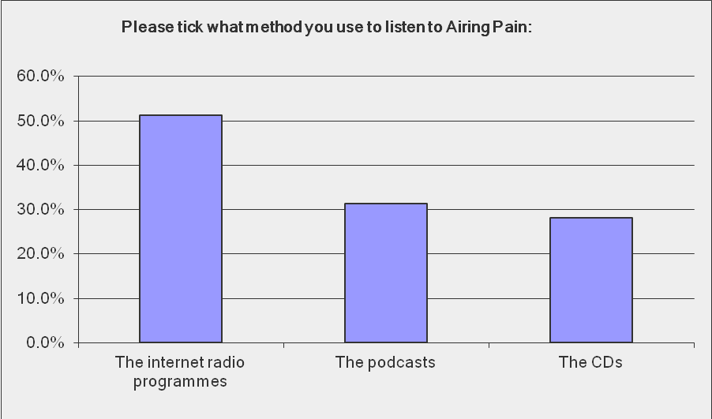

Slide 29
Value / benefit of the shows?
The fact that chronic pain is being recognised and discussed as a distinct condition
Seen as a helpline
Positive feedback on content and inclusion of information, news, and views – educative, an excellent resource ...
Sharing of experiences and accounts of real issues from real people
I loved the personal experiences and tips for self help and new interventions arriving
Its gives me a lifeline, in my own time; I feel part of a pain community

Slide 30
Has AIRING PAIN helped you?
Can you rate how Airing Pain has helped you?
Answer Options | Response Percent | Response Count
Not at All | 14.04% | 17
A little | 41.32% | 50
A lot 44.63% |  | 54
answered question |  | 121
skipped question |  | 3

Slide 31
Listen again to AIRING PAIN?
Do you ever listen to a programme more than once?
Answer Options | Response Percent | Response Count
Yes | 53.7% | 65
No | 46.3% | 56
Comment |  | 50
answered question |  | 121
skipped question |  | 3

Slide 32
Would you recommend AIRING PAIN?
Would you recommend Airing Pain to anyone?
Answer Options | Response Percent | Response Count
Yes | 92.6% | 112
No | 7.4% | 9
answered question |  | 121
skipped question |  | 3

Slide 33
Ideas for the future?
Limited information provided on whether programmes helped families, friends, carers
Respondents wanted to hear more from relatives living with those with chronic pain
More about alternative therapies
More about mental health and chronic pain
GPs and other professionals should listen to the shows ..... MARKETING and PUBLICITY ++

Slide 34
Conclusion about AIRING PAIN?
ACCESSIBLE
VALUABLE
More than 350 people regularly download the programmes
On-demand, free resource
No constraints of distance
“... is almost comforting because I lose the isolation of living with people who do not fully understand where I am coming from”
“... it is the most informative and helpful helpline for chronic pain sufferers. It has helped me seek further treatment for my condition, which I would not have known about if I had not listened to Airing Pain. It has also helped me improve the quality of my life and cope better ...”

